Slide 1
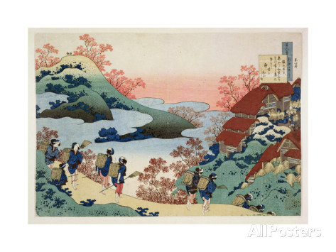
Asian Genealogy
Getting Started
Troy Goss
Notes:
Columbia Family History Center volunteer since March 2012
30 years searching own family history
Proficient in Chinese Mandarin, served six years in Korea
Studied wife’s Korean clan genealogy
Worked with patrons of Korean, Japanese, and Taiwanese descent at the FHC

Slide 2
Overview
八八
爸爸節快樂！

Slide 3
Overview: Target Audience
China, Taiwan*, Korea, Japan
Second/third-generation Americans
  Generally know their grandparents and origins
  Know little/some of their ancestral language, culture
  Have little/some contact with relatives overseas
Have or can get:
  Recent ancestors’ names (in characters)
  Ancestral home (in characters)
Notes:
Available records in Taiwan, by and large are from the Japanese era (1895-1945) forward. Nationalists
No readily identifiable Vietnamese records found on FamilySearch using “阮氏”

Slide 4
Overview
First Hour
  Records, U.S. and Asian
  Asian Languages and Chinese Characters
Second Hour
  Naming Conventions
  Asian Calendars
  Clan Genealogies and Family Registries
  Resources

Slide 5
Overview, I
U.S. Records
Asian Records, Overview
Asian Languages
Chinese Characters
Romanization

Slide 6
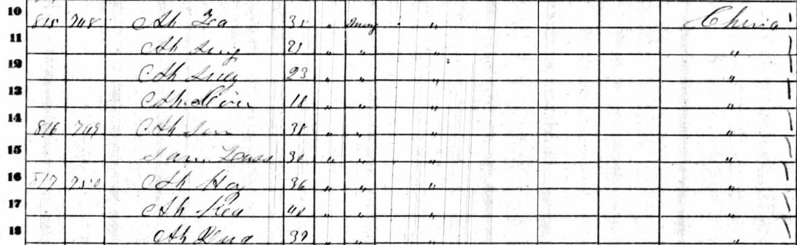
U.S. Records
Headstones
Naturalization applications
Census records likely insufficient:
Notes:
1860 Census, Mariposa County, California (Gold mining town); three households of gold miner men, all simply from “China” with informal, diminutive “Ah-” names (either with surname or last character of given name)—yet no characters, of course.

Slide 7
Asian Records
Household Registries (戶籍)
Clan Genealogies (族譜)
Headstone inscriptions
Ancestral Tablets (牌位、神位、神主)
Family Associations (宗親會、同姓會)
Land records
Censuses (modern era)

Slide 8
Household Registries (戶籍/戶口冊)
Running local government census
  Prefecture (州) or county* (縣)
  Family name and location
  Married daughters stricken from father’s family registry and added to husband’s
Notes:
The basic subdivisions below the province are prefectures, but the translations of 州 and 縣 vary over time; in modern China the “prefecture” is generally a larger “county.”
Taiwan: Some film titles suggest as far back as 1852 (ex. 1852-1936), but Taiwan items may be lumped together with Japanese records from that time.

Slide 9
Household Registries (戶籍/戶口冊)
Registry microfilms through Family Search
  China: 1780s (Qing)
  Taiwan: Japanese occupation (1895-1945) forward
  Korea: mid-1700s, Japanese occupation (1910-1945)
  Japan: 1830s (天保/ Ninkō Tenpō)
Notes:
Taiwan: Some film titles suggest as far back as 1852 (ex. 1852-1936), but Taiwan items may be lumped together with Japanese records from that time.
Korea: mostly 1890’s forward, but some as titled as far back as 1735, including those reconstructed from clan registries.
Japan: Emperor Ninkō’s (Meiji’s grandfather) third of four era names was Tenpō (1830-1844).

Slide 10
Clan Genealogies (族譜/宗譜)
Patrilineal Clan History
  Progenitor (始租) downward, mixed with legend
  Generally historical for about 800 years
  Ancestral rites
Family name and ancestral home, in characters
Branch (公派/派祖)
Earliest known ancestor’s name, in characters

Slide 11
Clan Genealogies (族譜/宗譜)
China: 中國, 族譜收藏, 1239-2013 familysearch.org/search/catalog/1787988

Slide 12
Yi Clan Genealogy (慶州李氏族譜)
Yi Al-pyeong (李謁平/이알평)
  Name bestowed by Silla's first king, Hyeokgeosei (赫居世/혁거세; reigned 57 BCE-4 CE)
  Such records, including the use of characters, did not begin until centuries later
  Third generation married into Koryo court 900 years later

Slide 13
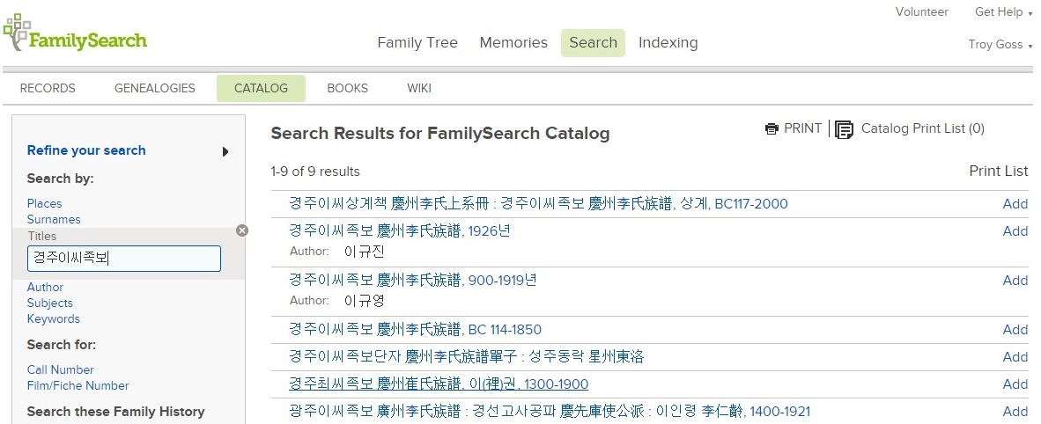
Clan Genealogies (族譜)
慶州李氏族譜 경주이씨족보

Slide 14
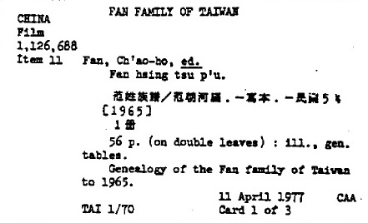
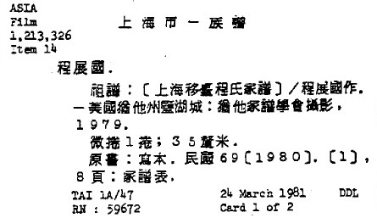
Clan Genealogies (族譜)
Salt Lake microfilm indexes, 1979-1984
  Romanized Wade-Giles and Traditional Vernacular
Film 1126688
Film 1213326

Slide 15
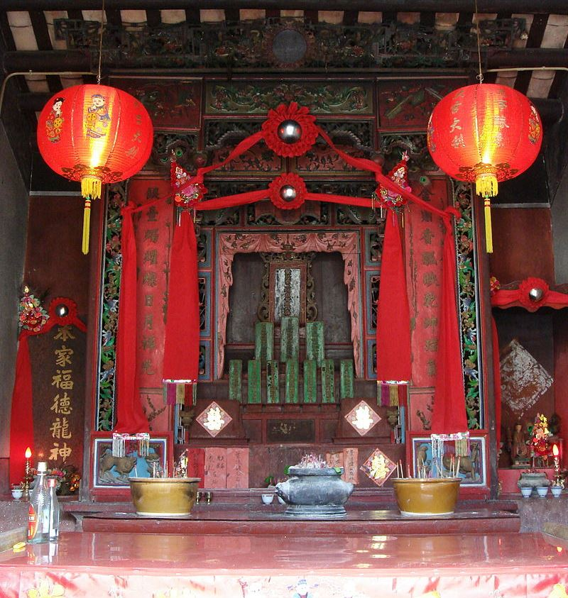
Ancestral Tablets (牌位、神位、神主)
Notes:
Ancestral altar in Hong Kong

Slide 16
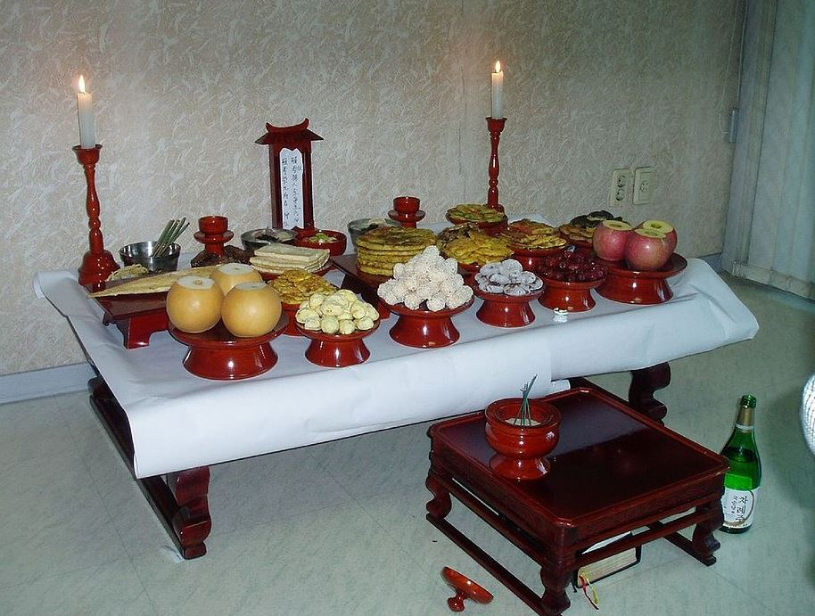
Ancestral Offerings
Notes:
Ancestral offerings, Korea

Slide 17
Family Names
Surnames (Chinese, also used in Korea*; alphabetized by Hanyu pinyin)
陳 (陈) | Chen, Ch’en (CM); Can (CC); Jin (KO); Chin (JP)
黃 | Huang (CM); Wong (CC); Hwang (KO); Ko (JP)
李 | Li (CM); Lei (CC); Yi, Ri, Ree, Rhee (KO); Ri (JP)
林 | Lin (CM); Lam (CC); Im, Rim (KO); Rin, Hayashi (JP)
孫 (孙) | Sun (CM); Syun (CC); Son (KO/JP)
王 | Wang (CM); Wong (CC); Wang (KO); O (JP)
楊 (杨) | Yang (CM); Joeng (CC); Yang (KO); Yo (JP)
袁 | Yuan (CM); Jyun (CC); Won (KO); En (JP); Nguyen, Vien (VN)
張 (张) | Zhang, Chang (CM); Zoeng (CC); Jang (KO); Cho (JP)
Surnames (Korean, also used in China*; alphabetized by Korean MR)
崔 | Ch’oi (KO); Cui (CM)
高 | Go, Ko (KO); Gao, Kao (CM); Gou (CC); Ko (JP)
趙 (赵) | Jo (KO); Zhao (CM); Ziu (CC); Cho (JP)
金 | Kim, Gim (KO); Jin (CM)
朴 | Pak, Bak (KO); Pu (CM)
吴 | O (KO); Wu (CM), Ng (CC); Kure, Go (JP)
Surnames (Japanese)
伊藤 | Ito
加藤 | Kato
小林 | Kobayashi
松本 | Matsumoto
中村 | Nakamura
佐々木 | Sasaki
Note: Knowing the pronunciation of a name is not enough:
Li/Lee: 李、黎
Wang: 王、汪

Slide 18
Characters and Language
Dialects & Languages
What are characters?
  Character components
  Stroke order
  Homophones
Romanization
Name conventions
Date Issues

Slide 19
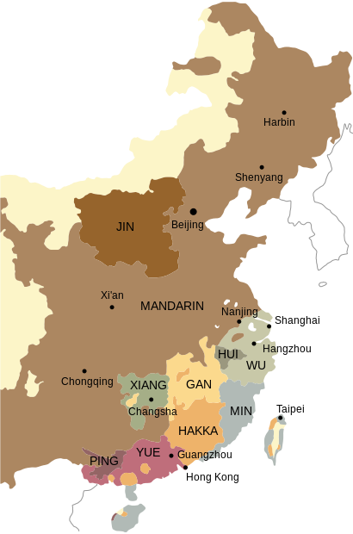
Chinese Dialects
Major Han* dialects
  Mandarin, North, South & Jin
  Wu [Shanghai] (6.5%)
  Min [Fujian/Taiwan] (6%)
  Yue & Pinghua [Canton] (5.2%)
  Hakka & Gan (2.5% & 1.7%)
  Xiang [Hunan] (3%)

Slide 20
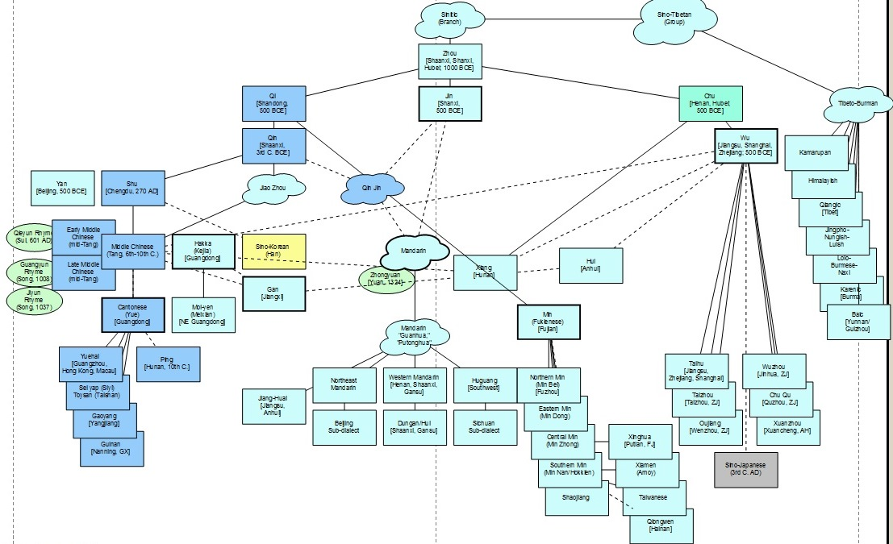
Language & Dialects
Mandarin
Hakka
& Gan
Cantonese

Slide 21
Chinese Influence
Vietnam, 2nd Century BCE, Han
Spread of Buddhism, 3rd & 4th Centuries CE
  Japan
    Sino-Japanese Kanji (漢子), 3rd Century Wu
    Phonetic Hiragana & Katakana, ~800 CE
  Korea
    Sino-Korean Hanja (漢子/한자), 4th Century (Shu?)
    Hangul (한글), 1443 (訓民正音/훈민정음)
Notes:
Hiragana = Japanese words without kanji characters
Katakana = transliteration of foreign words

Slide 22
Chinese Dialects
Major Han dialects
  Mandarin, North, South & Jin
  Wu [Shanghai] (6.5%)
  Min [Fujian/Taiwan] (6%)
  Yue & Pinghua [Canton] (5.2%)
  Hakka & Gan (2.5% & 1.7%)
  Xiang [Hunan] (3%)
Han
Notes:
Arrows depict:
Linguistic origin in North Central China
1. Migration of Qi (Shandong) to Xi'an for Qin
2. Jin influence on Qin at Xi'an
3-4. Chu in Central China splitting to Wu and Min
5. Mandarin migration south to Chengdu
6-7. Migration of Min
7. Southern Mandarin migration to Korea
8. Wu migration to Japan
9. Tang (Xi'an) migration to Canton (Yue)
10. Modern Mandarin throughout the Northwest (and rest of China)

Slide 23
Development of Characters
Shang Dynasty (~13th Century BCE)
  Oracle bones and tortoise shells
Zhou Dynasty (1046-256 BCE)
  Bronzes
Qin Dynasty (221-206 BCE)
  Standardization

Slide 24
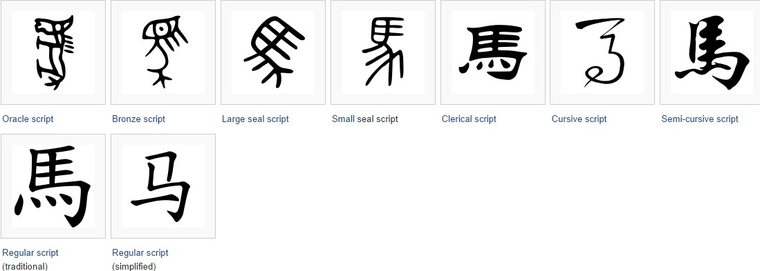
Development of Characters
Evolution of “horse”

Slide 25
Ideographs
Concrete: 日 月 木 田 心 人 女 馬
Abstract: 明 東 思 囚 安
Phonetics: 馬(mă): 媽 瑪 罵 嗎
…but: 甫(fŭ): 補(bŭ) 鋪 (pù)
Meaning (radical): 騎(qí), 駕(jiā), 駛(shĭ)
馬慢，媽駡馬。

Slide 26
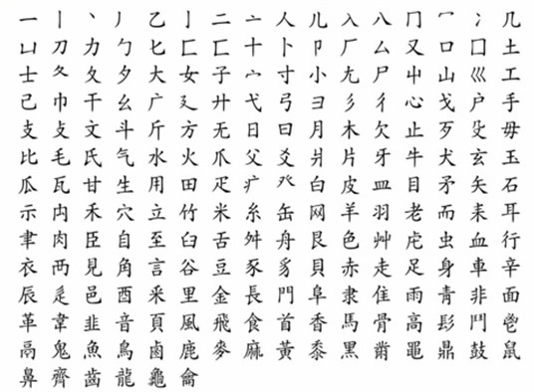
Radical Chart
By count
By stroke

Slide 27
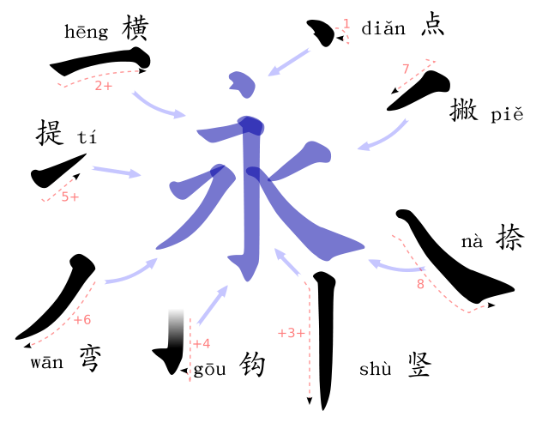
Stroke Order
dot (‘diăn’)
horizontal line (‘hēng’)
vertical line (‘shù’)
hook (‘gōu’)
up-stroke (‘tí’)
left-curve (‘wān’)
left-falling (‘piĕ’)
right-falling (‘nà’)
Another stroke, not
represented by ‘永’
is the right hook (乙).

Slide 28
Homophones (Mandarin)
石室诗士施氏，嗜狮，誓食十狮。施氏时时适市视狮。十时，适十狮适市。是时，适施氏适市。氏视是十狮，恃矢势，使是十狮逝世。氏拾是十狮尸，适石室。石室湿，氏使侍拭石室。石室拭，氏始试食是十狮尸。食时，始识是十狮尸，实十石狮尸。试释是事。
Shí shì shīshì Shī shì, shì shī, shì shí shí shī…
45+ “shi” characters in common use.
And this is why the Chinese will never abandon characters for a phonetic alphabet.
Notes:
"[In a] stone room [was a] poet [named] Shi [who had an] appetite for lion [and] swore to eat ten lions. Shi frequenty [went to the] market to look [for] lions. At 10 o'clock, ten lions [had just arrived at the] market. [At that very] time Shi [had just arrived at the] market. [When the] Shi saw there were ten lions he shot them with his trusty arrows and killed the ten lions. Shi picked up the ten lion corpses and [took them] to the stone room. The stone room was humid. Shi asked his servants to [tidy up] the stone room. [When the] room [was clean] he tried to eat the ten lion corpses. As [he] ate, he realized that those ten lion corpses were in fact ten stone lion corpses. Try to explain that."

Slide 29
Simplified Characters
門/门 gate/door | 國/国 nation | 萬/万 10,000 | 頭/头 head | 體/体 body
馬/马 horse | 會/会 meeting | 東/东 east | 廣/广 broad | 厰/厂 factory

Slide 30
Character Look-up Exercise
Count/Stroke
  室
  原
  廟
  配
  順
  墓

Slide 31
Character Look-up Exercise
室, 3 + 6 = 9
原, 2 + 8 = 10
廟, 3 + 12 = 15
配, 7 + 3 = 10
順, 9 + 3 = 12
墓, 3 + 10 = 13

Slide 32
Romanization
毛澤東
  Mao Tse-tung (Wade-Giles)
  Mau Dzedung (Yale)
  Mao Zedong (Hanyu pinyin)
慶州 / 경주
  Kyungju (MR)
  Gyeongju (MC)
And this is just Mandarin!
Reading of historical records requires familiarity with the old and the new

Slide 33
Overview, II
Naming Conventions
Date Issues
Clan Genealogy
Family Registry
Resources

Slide 34
Naming Conventions
Family name followed by given name
  Single-character family name + 1 or 2 given name
  Double-character family name + single given name
Generational names (字派/起派)
  李圭洛/이규락, 李圭元/이규원,
  李圭秀/이규수, 李圭文/이규문
  Or radical: 李翮/이핵, 李翩/이펵
Birth order: 伯, 仲,…

Slide 35
Date Issues
Era years and names
Sexagenary cycle of stems and branches
Lunar calendar
Age calculation

Slide 36
Dates, Era Years
Era/reign years, 1895 =
  31st year of Gojong (高宗), Korea
  28th year of Meiji (明治), Japan
  20th year of Guangxu (光緒), China
Era names
  Mutsuhito (睦仁), Meiji (明治), and posthumous
  Republic of China, 1912

Slide 37
Dates, Sexagenary Cycle
10 heavenly stems (ancient days of the week)
12 earthly branches (12-year orbit of Jupiter)
甲子 = 1624, 1684, 1744, 1804, 1864, 1924, 1984, 2044,…
  甲午 (甲子/1864 +甲午/30 = 1894)
甲 | 乙 | 丙 | 丁 | 戊 | 己 | 庚 | 辛 | 壬 | 癸
子 (Rat) | 丑 (Ox) | 寅 (Tiger) | 卯 (Rabbit) | 辰 (Dragon) | 巳 (Snake) | 午 (Horse) | 未 (Goat) | 申 (Monkey) | 酉 (Rooster) | 戌 (Dog) | 亥 (Pig)
Fortunately we have tables for this!

Slide 38
Dates, Lunar Calendar (農曆)
Jesuit revision (時憲書) adopted in 1645
  China, Korea, Japan, and Vietnam
  New moon prior to the spring equinox
  Varies between January 21 and February 21
  Month/day references will be 3 to 7 weeks off
十一月 (11th lunar month) ≠ “November”
  29D 11M 1900 (LDS lunar date convention)
Convert dates, but always retain the historical, native date reference.

Slide 39
Dates, Gregorian Calendar (陽曆)
Gregorian calendar “officially” adopted:
  Japan, 1873
  Korea, 1895…1962
  Republic of China, 1912; PRC, 1949
Age calculation
  Considered a year old at birth
  Add a year over Lunar New Year, rather than birthday
  i.e., a baby born before the New Year could be considered “2 years old” days or weeks later

Slide 40
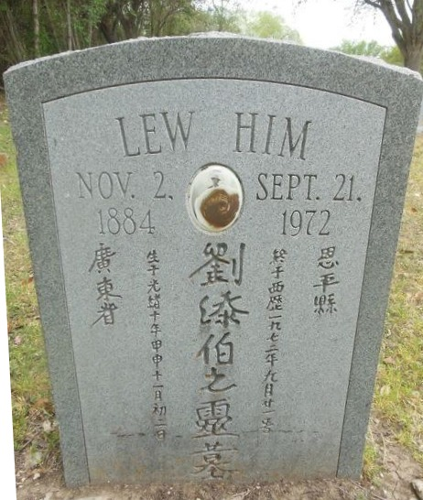
Headstone
劉添伯 Lew Him[-baa]
廣東省恩平縣
光緒十年甲申
  Guangxu 10th (from 1875)
  甲申, 21st year from 1864
  Both = 1884
十一月初二日
  11th Month directly
  transferred to Western

Slide 41
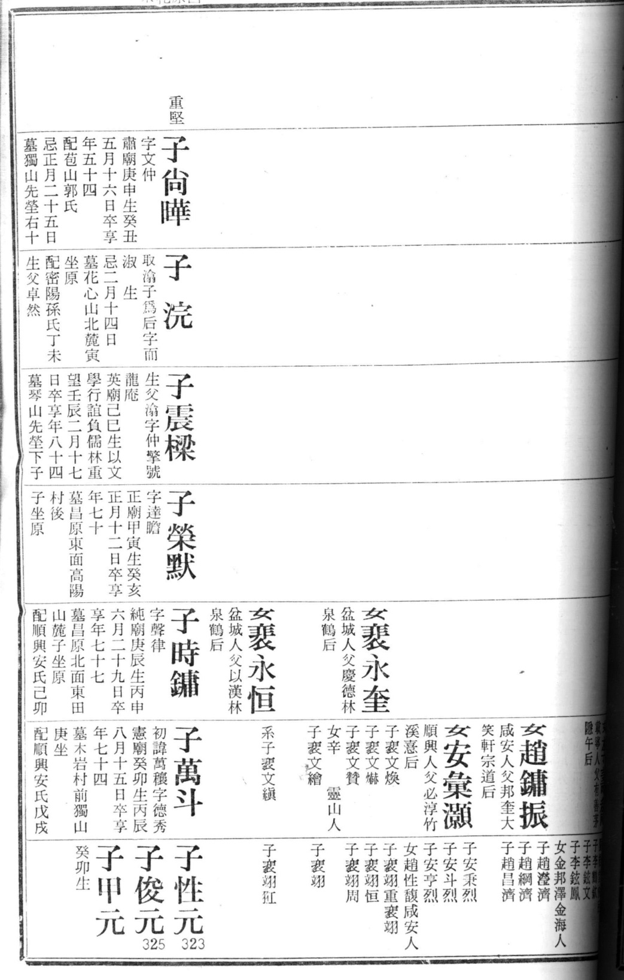
Kim Clan Genealogy
Seven generations (16-22)
  Right-to-left
  Naming conventions
  Daughters (女)/Sons-in-law

Slide 42
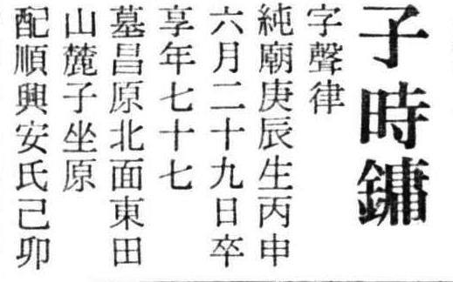
Kim Clan Genealogy
Kim Si-yong (金時鏞/김시용)
Style name (字): “Seong-ryul” (聲律/성률)
Born 庚辰 (~1820)
Died (29D 6M 1896), 77*
Burial location
Married to the An
family of Sunheung
[wife] born 己卯 (~1819)

Slide 43
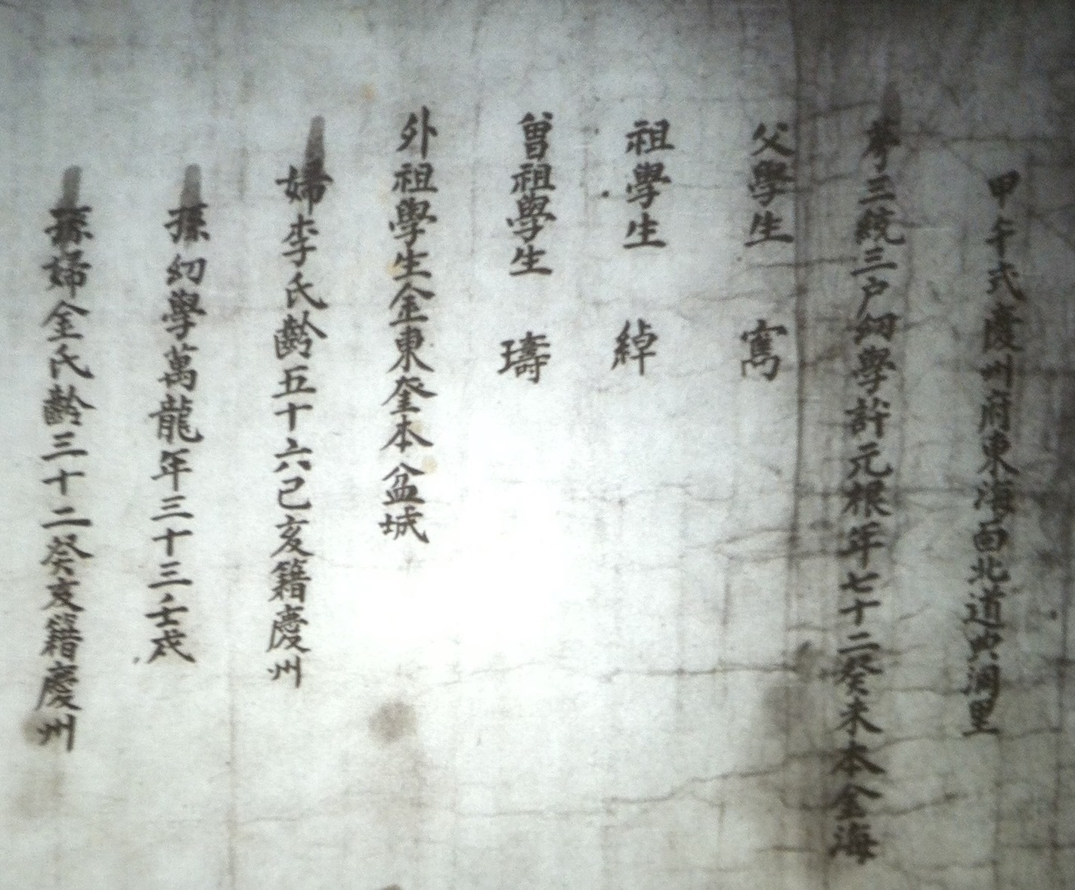
Heo Family Registry (許氏戶籍)
許元根 (1703)
Father, grands
Daughter-in-law
Grandson, wife
No full female names

Slide 44
Resources
“Decoding Asian Genealogy” (Word or PDF)
FamilySearch.org
  Wiki country research guides: “China,” “Korea,” “Japan”
  Catalog: Chinese, Korean, Japanese “clan genealogies” dating back to 17th Century

Slide 45
Resources
Native Wikis
  China: baike.baidu.com
    “100 Family Name,” baijiaxing.51240.com
  Korea: ko.wikipedia.org
Ancestry.com: limited beyond message boards

Slide 46
Troy Goss
www.genealogue.info

